Slide 1
Chapter 2
Chapters
1. Introduction
2. Graphs
3. Descriptive statistics
4. Basic probability
5. Discrete distributions
6. Continuous distributions
7. Central limit theorem
8. Estimation
9. Hypothesis testing
10. Two-sample tests
13. Linear regression
14. Multivariate regression
Organizing and Visualizing Data

Slide 2
Introduction & Re-cap…
Descriptive statistics involves arranging, summarizing, and presenting a set of data in such a way that useful information is produced.
Its methods make use of graphical techniques and numerical descriptive measures (such as averages) to summarize and present the data.
Statistics
Data
Information

Slide 3
Populations & Samples
Population
Sample
Subset
The graphical & tabular methods presented here apply to both entire populations and samples drawn from populations.

Slide 4
Definitions
A variable is some characteristic of a population or sample. Typically denoted with a capital letter: X, Y, Z…
E.g. student grades: X={B, A-, C, A, B,…}
The values of the variable are the range of possible values for a variable.
E.g. student marks (0..100)
Data are the observed values of a variable.
E.g. student marks: {67, 74, 71, 83, 93, 55, 48}

Slide 5
Types of Data & Information
Data (at least for purposes of Statistics) fall into three main groups:
Quantitative or (1) Numerical (Interval) Data:
Discrete Data, Continuous Data
Qualitative or Categorical Data:
(2) Ordinal Data, (3) Nominal Data,

Slide 6
Example: Types of Data
Person Nr. | age | age2 | income in $ | student year | major | weight in pounds
1 | 19 |  | 1000 | freshman | econ | 170
2 | 20 |  | 0 | sophomore | finance | 120
3 | 23 |  | 30000 | junior | finance | 147
4 | 20 |  | 2000 | senior | accounting | 160
To count number of observations per category use Excel:
= countif(cell,”sophomore”)
category | frequency | relative frequency
econ | 1 | 0.25
finance | 2 | 0.5
accounting | 1 | 0.25
sum | 4

Slide 7
Types of Data
Discrete
Data
Can you do
math?
Yes
1 Numerical Data
Continuous
No
Ordered?
Yes
2 Ordinal Data
Categorical Data
No
3 Nominal Data

Slide 8
1 Interval data
Real numbers, i.e. heights, weights, prices, etc.
Also referred to as quantitative or numerical.
Arithmetic operations can be performed on Interval Data, thus its meaningful to talk about 2*Height, or Price + $1, and so on.
Discrete Data: gaps exist between possible values
e.g. # of children in a family
Continuous Data: no gaps exist between possible values
e.g. annual income of a family

Slide 9
2 Ordinal Data…
Ordinal Data appear to be categorical in nature, but their values have an order; a ranking to them:
E.g. College course rating system:
poor = 1, fair = 2, good = 3, very good = 4, excellent = 5
While it’s still not meaningful to do arithmetic on this data (e.g. does 2*fair = very good?!), we can say things like:
excellent > poor or fair < very good
That is, order is maintained no matter what numeric values are assigned to each category.

Slide 10
3 Nominal Data…
The values of nominal data are categories.
E.g. responses to questions about marital status,
Single = 1, Married = 2, Divorced = 3, Widowed = 4
Because the numbers are arbitrary, arithmetic operations don’t make any sense (e.g. does Widowed ÷ 2 = Married?!)
Only counts of the number of items in a category are allowed.
More examples: gender, religious preference, etc.

Slide 11
Hierarchy of Data…
1 Interval
Values are real numbers.
All calculations are valid.
Data may be treated as ordinal or nominal.
2 Ordinal
Values must represent the ranked order of the data.
Calculations based on an ordering process are valid.
Data may be treated as nominal but not as interval.
3 Nominal
Values are the arbitrary numbers that represent categories.
Only calculations based on the frequencies of occurrence are valid.
Data may not be treated as ordinal or interval.

Slide 12
Graphical & Tabular Techniques for Nominal Data…
The only allowable calculation on nominal data is to count the frequency of each value of the variable.
We can summarize the data in a table that presents the categories and their counts called a frequency distribution.
A relative frequency distribution lists the categories and the proportion with which each occurs.

Slide 13
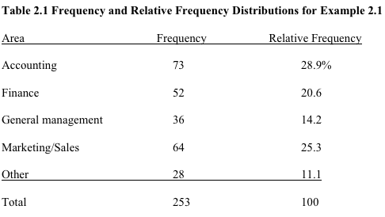
Nominal Data (Tabular Summary)

Slide 14
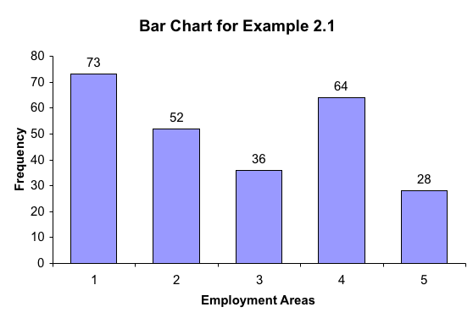
Nominal Data (Frequency)
Bar Charts are often used to display absolute frequencies…

Slide 15
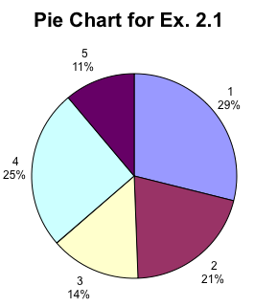
Nominal Data (Relative Frequency)
Pie Charts show relative frequencies…

Slide 16
Nominal Data
It’s all the same information, (based on the same data).
Just different presentation.

Slide 17
Graphical Techniques for Interval Data
There are several graphical methods that are used when the data are interval (i.e. numeric, non-categorical).
The most important of these graphical methods is the histogram.
The histogram is not only a powerful graphical technique used to summarize interval data, but it is also used to help explain probabilities.

Slide 18
Building a Histogram…
Create a frequency distribution for the data…
How?
a) Determine the number of classes to use.
b) Determine how large to make each class.
c) Place the data into each class…
classes are mutually exclusive and collectively exhaustive;
each item can only belong to one class;
classes contain observations greater than or equal to their lower limits and less than their upper limits -> […)
class limits; class mark; class interval

Slide 19
Example: Histogram
As part of a larger study, a long-distance company wanted to acquire information about the monthly bills of new subscribers in the first month after signing with the company.
The company’s marketing manager conducted a survey of 200 new residential subscribers wherein the first month’s bills were recorded.
The general manager planned to present his findings to senior executives.
What information can be extracted from these data?

Slide 20
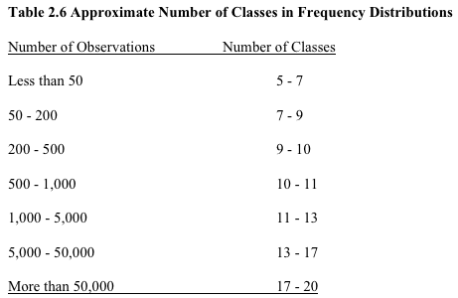
Building a Histogram
Collect the Data
Create a frequency distribution for the data…
How?
Determine the number of classes to use…How?
Refer to table 2.6:
With 200 observations, we should have between 7 & 10 classes…
Alternative, we could use Sturges’ formula:
Number of class intervals =
1 + 3.3 log (n)

Slide 21
Histogram
Collect the Data
Create a frequency distribution for the data…
How?
a) Determine the number of classes to use. [8]
b) Determine how large to make each class…
How?
Look at the range of the data, that is:
Range = Largest Observation – Smallest Observation
Range = $119.63 – $0 = $119.63
Then each class width becomes:
Range ÷ (# classes) = 119.63 ÷ 8 ≈ 15

Slide 22
Example: Histogram
In the previous example we created a frequency distribution of the 5 categories.
In this example we also create a frequency distribution by counting the number of observations that fall into a series of intervals, called classes.
We have chosen eight classes defined in such a way that each observation falls into one and only one class.

Slide 23
Example: Histogram
Classes
Amounts that are less than 15; [0, 15)
Amounts that are more than or equal 15 but less than 30; [15, 30)
Amounts that are more than or equal 30 but less than 45; [30, 45)
Amounts that are more than or equal 45 but less than 60; [45, 60)
Amounts that are more than or equal 60 but less than 75; [60, 75)
Amounts that are more than or equal 75 but less than90; [75, 90)
Amounts that are more than or equal 90 but less than 105 ; [90, 105)
Amounts that are more than or equal 105 but less than 120 ; [105, 120)

Slide 24
Example: Histogram

Slide 25
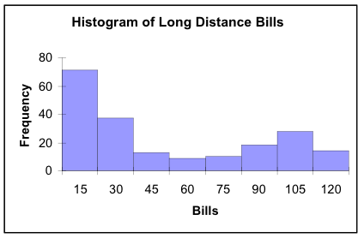
Interpretation
about half (71+37=108)
of the bills are “small”,
i.e. less than $30
(18+28+14=60)÷200 = 30%
i.e. nearly a third of the phone bills
are $90 or more.
There are only a few telephone
bills in the middle range.

Slide 26
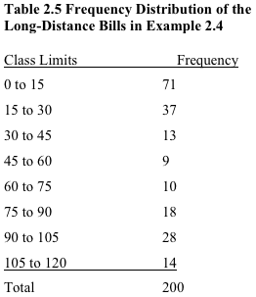

Slide 27
Shapes of Histograms…
Symmetry
A histogram is said to be symmetric if, when we draw a vertical line down the center of the histogram, the two sides are identical in shape and size:
Frequency
Frequency
Frequency
Variable
Variable
Variable

Slide 28
Shapes of Histograms…
Skewness
A skewed histogram is one with a long tail extending to either the right or the left:
Frequency
Frequency
Variable
Variable
Positively Skewed (Right Skewed)
Negatively Skewed (Left Skewed)

Slide 29
Shapes of Histograms…
Modality
A unimodal histogram is one with a single peak, while a bimodal histogram is one with two peaks:
Bimodal
Unimodal
Frequency
Frequency
Variable
Variable
A modal class is the class with
the largest number of observations

Slide 30
Shapes of Histograms…
Bell Shape
A special type of symmetric unimodal histogram is one that is bell shaped:
Many statistical techniques require that the population be bell shaped.
Drawing the histogram helps verify the shape of the population in question.
Frequency
Variable
Bell Shaped

Slide 31
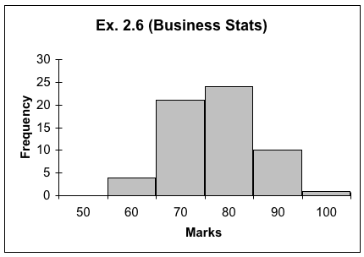
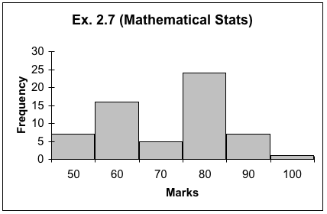
Histogram Comparison
The two courses, Business Statistics and Mathematical Statistics have very different histograms…
unimodal vs. bimodal
spread of the marks (narrower | wider)

Slide 32
Frequency Polygon
It is a line version of the histogram.
It is plotted using class midpoints as X values and frequencies as Y values.
Refer to Lab Manual Chapter 2!

Slide 33
Ogive…
(pronounced “Oh-jive”) is a graph of a cumulative frequency distribution.
We create an Ogive in three steps…
1) First, from the frequency distribution created earlier, calculate relative frequencies:
Relative Frequency = # of observations in a class Total # of observations
2) Calculate cumulative relative frequencies by adding the current class’ relative frequency to the previous class’ cumulative relative frequency.
(For the first class, its cumulative relative frequency is just its relative frequency)

Slide 34
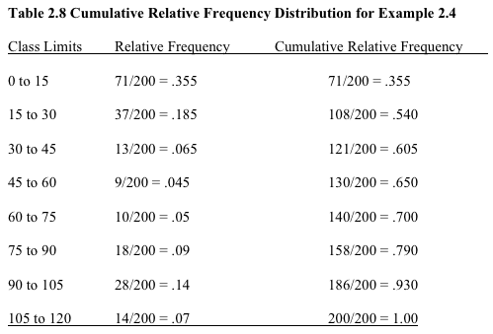
Cumulative Relative Frequencies…
first class…
next class: .355+.185=.540
:
:
last class: .930+.070=1.00

Slide 35
Ogive…
Is a graph of a cumulative frequency distribution.
1) Calculate relative frequencies.
2) Calculate cumulative relative frequencies.
3) Graph the cumulative relative frequencies…

Slide 36
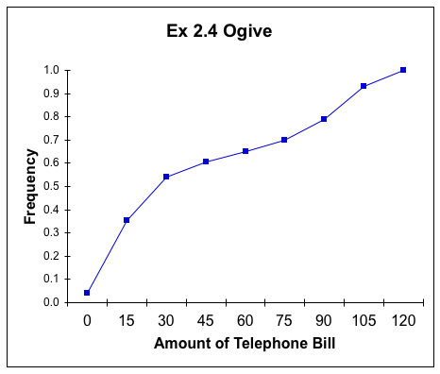
Ogive…
The Ogive can be used to answer questions like:
What telephone bill value is at the 50th percentile?
“around $35”
(Refer also to Fig. 2.13 in your textbook)

Slide 37
One Nominal Variable
Bar or Column Chart:
X axis: category labels
Y axis: absolute frequencies
Pie Chart: relative frequency
Pareto Diagram: a special type of column chart categories are ordered from left to right, largest frequency to smallest

Slide 38
Graphing the Relationship Between Two Interval Variables
How two interval variables are related? We employ a scatter plot, which plots two variables against one another.
Example 2.9 A real estate agent wanted to know to what extent the selling price of a home is related to its size…
Collect the data ✓
Determine the independent variable (X – house size) and the dependent variable (Y – selling price) ✓
Use Excel to create a “scatter plot”…

Slide 39
Patterns of Scatter Plots…
Linearity and Direction are two concepts we are interested in
Positive Linear Relationship
Negative Linear Relationship
Weak or Non-Linear Relationship

Slide 40
Time Series Data…
Observations measured at the same point in time are called cross-sectional data.
Observations measured at successive points in time are called time-series data.
Time-series data graphed on a line chart, which plots the value of the variable on the vertical axis against the time periods on the horizontal axis.

Slide 41
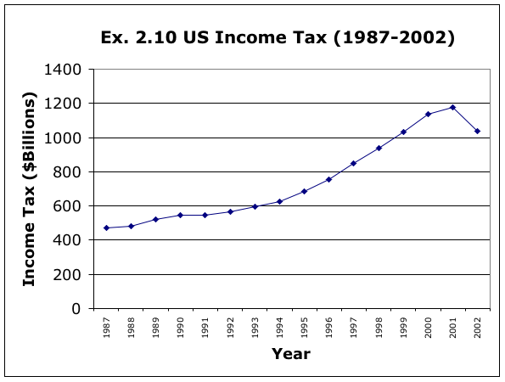
Line Chart…
From ’87 to ’92, the tax was fairly flat. Starting ’93, there was a rapid increase taxes until 2001. Finally, there was a downturn in 2002.

Slide 42
Appendix

Slide 43
Summation Notation
where a and b are integers satisfying
a is the starting value for i, b is the ending value.
The above notation is to sum up to .

Slide 44
That is, for variable X where X has values
The sum of all the values of X can be written as
If all the values for X’s are given, we can get the value for

Slide 45
Example:
Suppose X1=2, X2=0, X3=2, X4=5, and X5=1

Slide 46
In general,
Example:
, while

Slide 47
Summary II…
 | Interval Data | Nominal Data
Single Set of Data | Histogram Ogive Frequency Polygon Stem-and-Leaf | Pie Charts Column/Bar Chart Pareto Diagram
Relationship Between Two Variables | Scatter Plot | Contingency Table, Bar Charts

Slide 48
Review: Chapter 2 - Graphs
What is categorical data?
What is numeric/interval data?
What graphs can you make for ordinal data?
What graphs can you make for interval data?
What are the steps involved in making a bar chart in Excel?
How do you make a histogram in Excel?

